Slide 1
Milk somatic cell count, composition and yield of multibreed dairy cattle in Ethiopia
Tegegn Fantahun^{1,2,3}; Tegegn, Okeyo Mwai⁴; Selam Meseret³; Enyew Negussie⁶; Raphael Mrode^{4,5}; Getinet Mekuriaw^{1,5}; Zewdu Edea²; Gebregziabher Gebreyohanes⁴; Chinyere Ekine-Dzivenu⁴, Asrat Tera⁶ and Tesfaye S. Tessema ¹
¹AAU; ² Bio and Emerging Technology Institute (BETi); ³ILRI,AA and ⁴Nairobi; ⁵SRUC, UK; ⁶LUKE, Finland; LDI⁶
8th All Africa Conference on Animal Agriculture
Gaborone, Botswana, 26-29 September 2023

Slide 2
Introduction
Milk is a source of high quality proteins and bioavailable micronutrients (Haug et al., 2007; Tricarico et al., 2020).
Increased SCC level negatively affected milk composition and quantity (Guo et al., 2010; Cinar et al., 2015; Potter et al., 2018).
Different countries have a regulation on milk quality, payment based on the milk composition and somatic cells (IDF,2013; Moradi et al., 2021).

Slide 3
Introduction…
In sub-Sahara African countries, milk quality testing and control is not consistently undertaken (Özkan Gülzari et al., 2020).
In Ethiopia,
  large cattle population (70 million) (CSA, 2021),
  huge milk deficit (about 4.5 billion liters) per year (Tricarico et al., 2020).
  highest rate of mastitis (Motaung et al., 2017)
Therefore, the objective of this study was to determine the SCC levels, milk composition, milk yield and genetic and non-genetic factors that affect such traits in Ethiopian dairy farms.

Slide 4
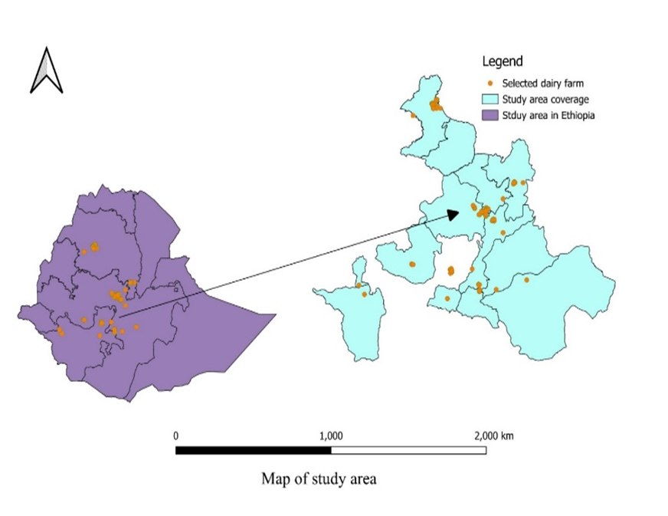
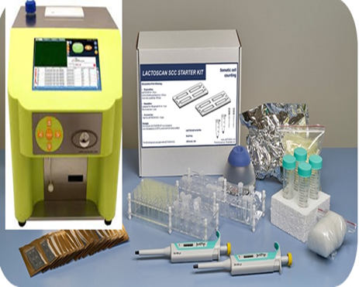
Materials and Methods
Data collected
SCC, fat, protein, lactose, salt, solid not fat, density, conductivity, total solids, milk yield
  1795 cows and 3588 records
  July 2021 to May 2023 study period
  201 dairy farms
  24 districts
Data recorded from ADGG database and farms (parity, birth data, calving date, breed, sampling date)

Slide 5
Statistical analysis
Outlier data were cleaned, 1741 cows and 3386 records remained for further analysis.
SCC class were grouped:≤ 200×10³, 201-250×10³, 251-350×10³, 351-500×10³ and >501×10³ cells/mL.
General linear model(sasLM package in R) were fitted for SCS (Model1) and yield and milk composition traits(Model2)
  Y_{ijklmno=} µ₊ B_{i+} P_{j +} L_{k +} S_{l +} A_{m +} H_{n +} e_{ijklmno} [1]
  Y_{ijklmnop=} µ₊ B_{i+} P_{j +} L_{k +} S_{l +} A_{m +} H_{n +} C_{o +} e_{ijklmnop} [2]

Slide 6
Summary statistics of milk SCC/SCS, composition and milk yield
Traits | Overall Mean | Breed
 |  | BHFC | HFC | Jersey | Local
 |  | (n²=6.1) | (n = 90.3) | (n =2.4) | (n =1.2)
 |  | Mean±SD³ | Mean ± SD | Mean ± SD | Mean ± SD
SCS (cells/mL) | 12.39 | 12.34±1.53 | 12.34±1.5 | 11.78±1.31 | 10.23±1.66
SCC (cells/mL) | 655663 | 609662±1017305 | 675637±1028310 | 246795±262683 | 133266.5±394955
Lactose (%) | 4.75 | 4.97±0.29 | 4.73±0.36 | 4.97±0.31 | 5.12±0.25
Protein (%) | 3.17 | 3.30±0.2 | 3.15±0.24 | 3.27±0.2 | 3.41±0.16
SNF (%) | 8.64 | 9.01±0.53 | 8.6±0.65 | 8.98±0.56 | 9.3±0.45
Salt (%) | 0.70 | 0.73±0.05 | 0.699±0.0.05 | 0.73±0.0.05 | 0.76±0.04
Fat (%) | 2.61 | 2.76±1.33 | 2.54±1.7 | 5.03±1.75 | 2.52±1.95
TS (%) | 11.24 | 11.77±1.49 | 11.12±1.93 | 14±10.97 | 11.82±2.15
EC (mS/cm) | 6.07 | 5.85±1.1 | 6.11±1.02 | 5.83±0.85 | 4.96±0.63
Density (kg/m³) | 1030.4 | 1031.75±2.18 | 1030.34±2.7 | 1029.67±2.24 | 1033.01±1.93
MY (liters) | 10.5 | 10.54±4.49 | 10.72±5.07 | 5.73±2.46 | 3.21±1.18

Slide 7
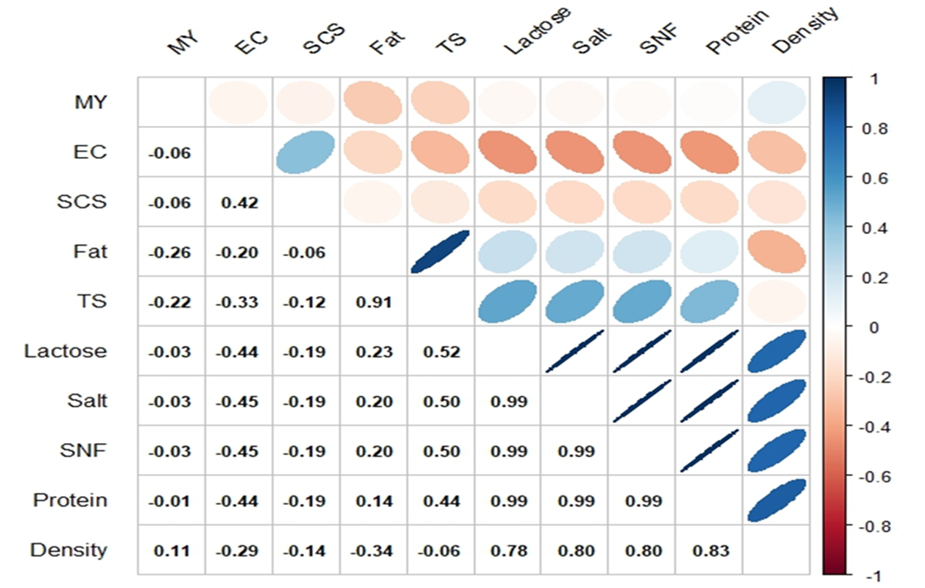
Association of SCS with milk composition and yield
non-significant (p>0.05) negative correlation was recorded between milk yield, lactose, SNF, protein and salt.

Slide 8
Effects of genetic and non-genetic factors
Main factors | Significant milk traits
Genetic factors Breed, Lactation stage
Breed & lactation stage | SCS, Lactose, Protein, SNF, Salt, TS, Fat, Density, EC and milk yield
SCC class | Lactose, Protein, SNF, Salt, TS, Fat, Density, EC and milk yield |  | Fat
Parity number | SCS, Lactose, Protein, SNF, Salt, TS, Density, and EC |  | milk yield
Non-genetic factors
Herd size & Location | SCS, Lactose, Protein, SNF, Salt, TS, Fat, Density, EC and milk yield
Sampling season | EC and milk yield | SCS, Lactose, Protein, SNF, Salt, TS, Fat, Density, | SCS, Lactose, Protein, SNF, Salt, TS, Fat, Density,

Slide 9
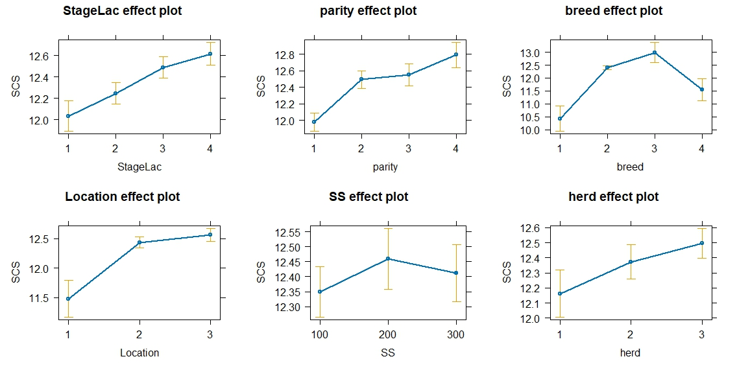
Effects of genetic and non-genetic factors on SCS

Slide 10
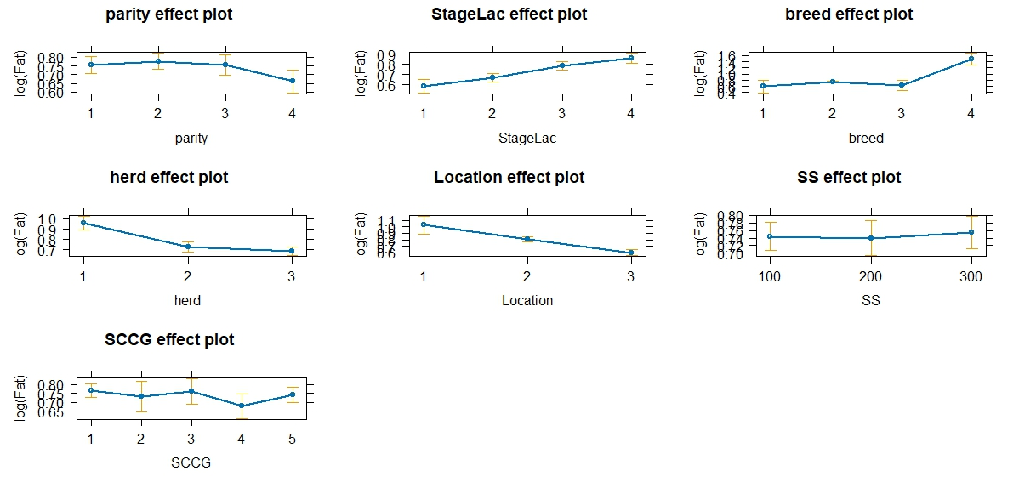
Effects of genetic and non-genetic factors on Fat

Slide 11
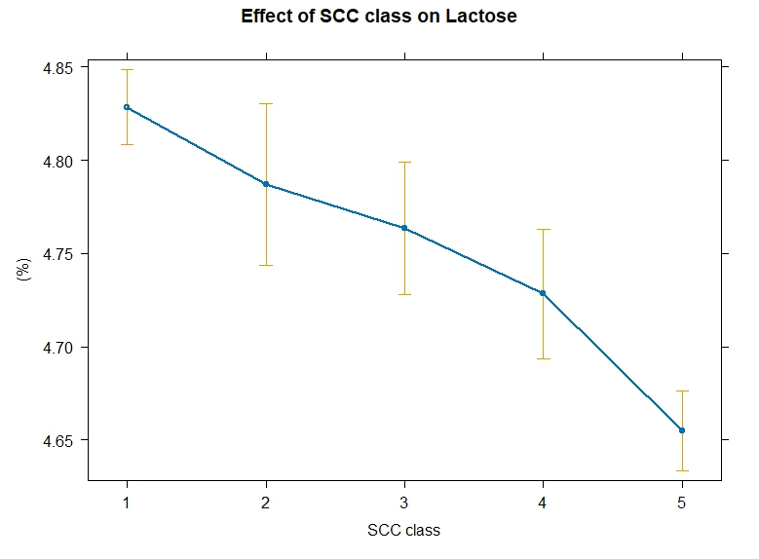
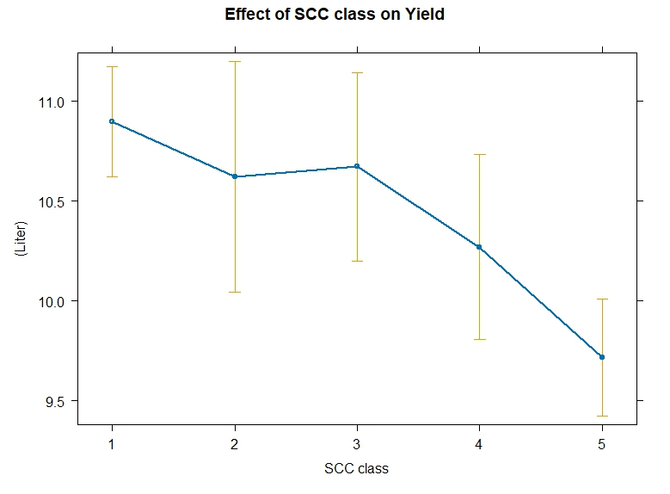

Effects of genetic and non-genetic factors

Slide 12
Conclusion
Results showed that the high SCC and low-fat content would negatively affect milk quality and udder health.
The milk composition and test-day milk yield were negatively associated with SCS except EC.
SCC class ≥ 500x10³ cells/mL had a detrimental effect on the quantity and composition traits in the study dairy farms.
Thus, breed type, admixture level, stage of lactation, and herd management should be considered for the selection of cattle for reduced SCC, improved milk yield and milk quality.

Slide 13
Acknowledgments
ADGG project
LDI, Ethiopia
IoB, Addis Ababa University
Dairy farmers

Slide 14

Thank you!
THANK YOU

