Slide 1
Operationalizing One Health in pastoralist settings

Slide 2
Module 1: Principles and applications of One Health

Slide 3

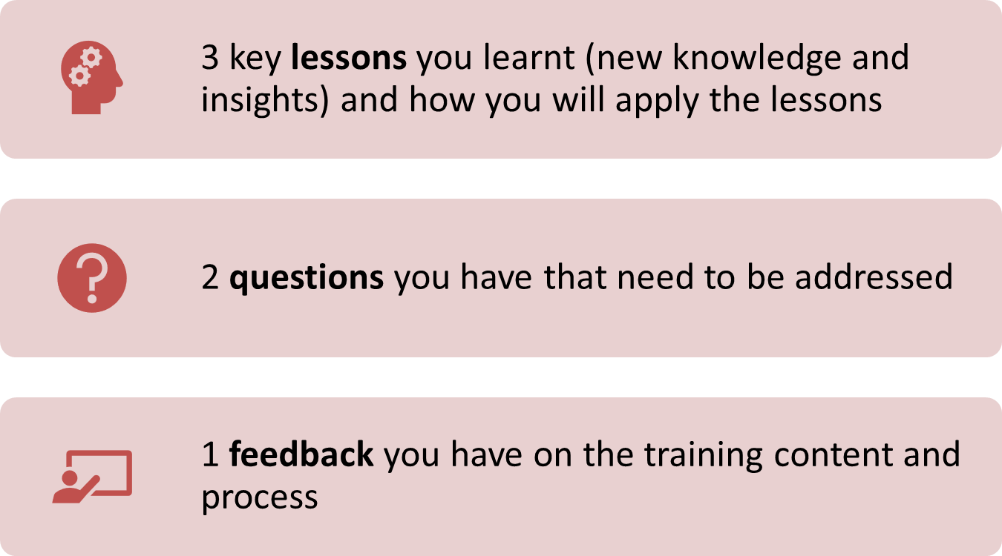
Re-cap Day 4
Reflection
Write down your key lessons from yesterday
Be prepared to share your responses in plenary
30 minutes

Slide 4
Participatory community engagement in One Health

Slide 5

Intended learning outcomes
By the end of today, you will be able to:
describe the key actors/stakeholders in One Health;
describe the meaning of community participation and identify approaches used to engage community in One Health initiatives; and
identify participatory skills, tools, and methods, and appreciate why they are important in participatory process management

Slide 6
Topics
Actors/stakeholders engaged in One Health
Meaning of community engagement
Approaches to community engagement
Levels of participation
Attitudes, skills and tools for effective participatory engagement in One Health

Slide 7
Recall the meaning of transdisciplinary collaboration
Different disciplines/practitioner groups
Community and government stakeholders
Multi-disciplinary
Interdisciplinary
Transdisciplinary
Methods B
Solution
Defining a problem
Shared methods
Methods A
Solution
Defining a problem
Shared methods
Solution
Solution
Solution
Same or similar problem
Methods C
Solution
Solution
Combination of ideas or methods from different disciplines. Teams from human, animal and environmental health work either concurrently or in sequence, but the activities of their respective disciplines run parallel and do not blend
Integration of ideas and methods from different disciplines. Teams from human, animal and environmental health work together to jointly frame a problem, agree on a methodological approach, and analyze it. May come up with different solutions.
Creation of new ideas and methods informed by diverse perspectives. Goes beyond interdisciplinary collaboration, to include participatory approaches that engage multiple levels of stakeholders, including the community, academia, and government
Notes:
Transdisciplinary collaboration goes beyond interdisciplinary collaboration, to include participatory approaches that engage multiple levels of stakeholders, including the community, academia, and government.
Explain that the focus for today is about stakeholder engagement.

Slide 8
Actors/stakeholders in One Health
Interactive plenary discussion
What do you understand by the following terms?
  Stakeholder
    Actor
    Primary vs secondary stakeholder
  Community
15 minutes
Notes:
According to NEOH, stakeholder is ‘any individual, group or organization who may affect, be affected by, or perceive themselves to be affected by a decision or activity’ while actors are a subgroup of stakeholders such as ‘any individual, group or organization who acts, or takes part in the context of the One Health initiative’ (Rüegg et al., 2018).
In general, stakeholders who should be engaged in One Health initiatives include:
Primary stakeholders: people or groups that stand to be directly affected, either positively or negatively, by an effort or the actions of an agency, institution, or organization
Secondary stakeholders: people or groups that are indirectly affected, either positively or negatively, by an effort or the actions of an agency, institution, or organization
Community is a group of people who are brought together by something in common, such as cultural background, shared experience, and geographic location.

Slide 9
Key actors/stakeholders in One Health
Communities: men and women from rural, urban, and mobile communities, including from different ethnic, religious, and cultural backgrounds, who are affected by problems such as zoonotic diseases, antimicrobial resistance, environmental degradation, and climate change
  Role: help prioritize problems and identify solutions.

Slide 10
Key actors/stakeholders in One Health
NGOs; professional organizations, universities and other knowledge institutions
  Role: stewardship; research, resource mobilization; generation of knowledge; capacity development; intervention design; and implementation of One Health initiatives
Relevant line ministries (national/sub-national)
  In One Health includes ministries for: health, agriculture/livestock, and natural resources/environment (amongst others)
  Role: formulation and implementation of policies for the promotion of health and disease control; high-level coordination for One Health; strategic planning

Slide 11
Key actors/stakeholders in One Health
Permanent regional bodies and ad hoc networks
  E.g. Africa CDC – works with member states to strengthen capacity in relevant areas
Multilateral organizations
  “Quadripartite alliance for One Health”: FAO, WOAH, UNEP, WHO
  Role: provide upstream policy and legislative advice and technical assistance to Member States; provide a framework for action to encourage best practices in One Health across the globe

Slide 12
Meaning of community engagement
Interactive plenary discussion (video)
Facilitator will show a video
As you watch consider:
  What do you understand by the term ‘community engagement’
  What are the benefits of community engagement?
Video 7: What is community engagement?
https://www.youtube.com/watch?v=Eqwxife716M
15 minutes

Slide 13
Meaning of community engagement
According to CDC, community engagement:
‘involves partnerships and coalitions that help mobilize resources and influence systems, change relationships among partners, and serve as catalysts for changing policies, programs, and practices’
* Other terms for community engagement: citizen engagement, community collaboration, community consultation, community conversation, community development, community dialogues, community empowerment, community management, stakeholder engagement, stakeholder management, public consultation, public participation

Slide 14
Benefits of engaging communities in One Health
Increases the options available to people to exercise more control over their health as well as the health of their livestock and surrounding environments
Involves participation of the people themselves in setting priorities, making decisions, as well as implementing and evaluating them, ensuring One Health initiatives stay on track
Ensures that the responsibility for health promotion is shared among individuals, community groups, professionals, institutions and governments

Slide 15
Four approaches to community engagement
Community-oriented (informed) | Community- based (shaped) | Community-managed (driven) | Community-owned
Community is informed and mobilized to participate in addressing immediate short-term concerns with strong external support | Community is consulted and involved to improve access to services and programmes by locating interventions inside the community with some external support | There is collaboration with leaders of the community to enable priority setting and decisions from the people themselves with or without external support of partners | Community is empowered to develop systems for self-governance, establish and set priorities, implement interventions with partners and external support groups as part of a network
Organization-led Community-led
Organization holds power Community holds power
and makes key decisions and makes key decisions
Notes:
Each approach is distinct, and one is not of a higher order than the other. Not all communities at all times are capable or interested in owning an initiative. Depending on the scenario it may make sense for organizations/authorities to lead a One Health initiative. Conditions for community-led approaches are met when there is shared community concern, a sense of responsibility and a desire to act.

Slide 16
Goals of community engagement
Small group discussion
Below are some adjectives we often use to describe the reasons for engaging with communities
At your table, discuss the terms and put them in order from more passive to more active participation by communities
15 minutes
involve
collaborate
inform
empower
consult

Slide 17
Goals of community engagement
Inform | Consult | Involve | Collaborate | Empower
To give community information | To ask community their opinion | To include communities in decision-making | To partner with communities | Community delivers solutions
As you move from left to right, there is more active participation by the community i.e. spectrum of public participation
To ensure sustainability, over time, a successful One Health initiative should move along this continuum toward greater community empowerment
Notes:
Emphasize that different approaches and tools are needed for different One Health problems, depending on the ultimate aim of the engagement. Over time, One Health initiatives should aim to empower communities so that they can take control of their own health and well-being, and that of their animals and surrounding environment. This ensures that initiatives will be sustainable.

Slide 18
Spectrum of public participation
Small group discussion
How does the spectrum of public participation help you understand community engagement?
How do you think the spectrum of participation and approaches to community engagement align?
For each level of participation: identify one example of a One Health problem or challenge that would be best addressed using the stated level of participation. Be specific about the methods you would use to engage communities for the stated goal.
45 minutes

Slide 19
Attitudes and behaviours for effective community engagement
Interactive plenary discussion
Discussion prompts:
  What attitudes and behaviors do you think contribute to effective participatory engagement of stakeholders in One Health initiatives?
15 minutes

Slide 20
Attitudes and behaviours that are conducive to participatory processes
A belief that every idea/view counts – do not judge opinions as right or wrong
Adopting a learning attitude – try to understand ideas and opinions of others and ask for clarification when you don’t understand
Practicing flexible working – re-think and re-plan based on an openness to other peoples’ ideas and opinions
Transparency – communicate openly and foster mutual trust and respect; try to find common language
Positive working style – practice active listening and don’t interrupt when others are expressing their views and opinions

Slide 21
Participatory tools and methods
Way in which community engagement and participation are translated into implementation
  Include specific activities designed to provide a structured approach to encourage joint analysis, learning and action
Depending on your role/responsibilities, you may find it useful to look up the following tools and methods:
  Participatory Rural Appraisal (PRA)
  Participatory Action Research (PAR)
  Participatory Hygiene and Sanitation Transformation (PHAST)
  Participatory Epidemiology (PE)
  Participatory Rangeland Management (PRM)

Slide 22
Putting it all together
Interactive plenary discussion
This session is reserved for learning integration and reinforcement
Facilitator may invite you to review:
  Training objectives and topics
  Daily recaps
  Feedback
  Learning logs
  Self-assessment questions
45 minutes

Slide 23
Summary of key learning points
One Health is a way of thinking, planning and working that is founded on the recognition that human, animal, and environmental health is interdependent
Systems thinking is needed to solve complex problems that stem from this inter-dependency, with awareness that decisions taken in one part of the system (or sector) can impact other parts of the system (or sector).
Evidence is needed from multiple sectors to inform better decisions

Slide 24
Summary of key learning points (continued)
One Health is operationalized by nurturing collaboration and coordination between sectors, and engages many stakeholders, including communities, toward the goal of achieving healthy humans, animals, and ecosystems
One Health practitioners need strong technical skills to contribute their disciplinary expertise to multi-sectoral teams. Practitioners also need a range of interpersonal “soft” skills to engage communities effectively, and work across sectors with people of different backgrounds.

Slide 25
Action plan
Small group discussion
In groups by woreda/district:
  Make action plans to apply the training
  Record your discussion on a flipchart
  Place flip chart on wall
Be prepared to review and vote on the best action plan
15 minutes

Slide 26
Evaluation
Your facilitator will distribute two forms:
  Post-training evaluation – measures the level of learning achievement relative to the baseline you completed on day 1
  End-of-training survey – gathers participant feedback on the relevance, effectiveness of the content and training process
Both forms are anonymous and will help us improve the training
5 minutes

Slide 27
Thank you for your active participation
አመሰግናለሁ
mahadsanid
danke
merci
galatoomaa
asante
grazie

